Slide 1
Partnering With
Connor, Clark & Lunn Private Capital
Darin Thompson, CFA
Vice President / Portfolio Manager
CC&L Private Capital
416-867-3065
dthompson@cclgroup.com
David Yurich CFP®, RFP, CLU
Financial Advisor
Dundee Private Investors Inc.
705-522-1422
dave@soundfs.ca

Slide 2

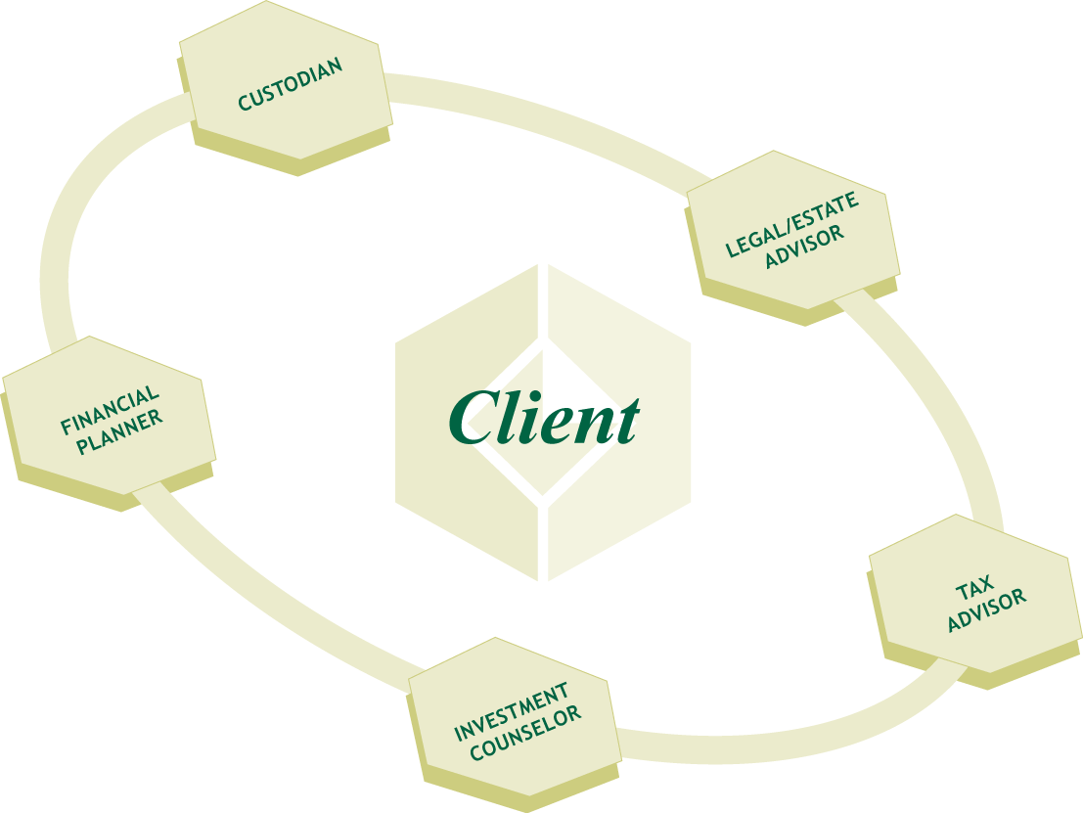

Personal Advisory Board
Keeping all advisors focused and cooperative

Slide 3

Home Construction Project
Client
Architect’s Professional Advisors
Structural Engineer
Land Surveyor
Environmental Engineer
Architect - CCO - (Chief Construction Officer)
General Contractor
Site Preparation
Contractor
Framing
Contractor
Finishing
Trades
Plumbing
Contractor
Electrical
Contractor
Heating/A.C
Contractors
Carpenters

Slide 4
CC&L Private Capital Model
Client
$1.0 Million
Client’s Professional Advisors
Accountant
Lawyer
Quarterback – David Yurich
Connor, Clark & Lunn Private Capital
Investment Counselor / Portfolio Manager
Portfolio Management
Tax
Management
Investment
Management
Income Generating
Bonds
International
Equities
Domestic
Equities
Alternative
Asset Classes

Slide 5

Connor, Clark & Lunn Private Capital Ltd.
Independence: Owned entirely by the partners of the firm – no conflicts!
Focused: Our only business is managing investments
Depth and stability:
  -In business since 1982
  -Over $35 billion under management
  -Canadian firm, International organization
  -Professional Staff – 56 CFAs
“Experience”
Notes:
We are an independent firm owned by its employees who are partners in the firm
Each affiliate is a partnership owned jointly by its employees and the parent company CC&L FG
All we concentrate on is IM – no conflict of interest on I Banking Trading etc
Over 32 billion AUM - $30 billion institutional just over 1.4 b in PC – institutional mindset to PC clients
Cdn roots with international affiliations
Professional staff

Slide 6

Connor, Clark & Lunn Financial Group Clients
Private Clients
Over 1200 families across Canada
Financial Institutions
Six chartered banks
Corporations
Over 175 institutional clients
Aboriginal Clients & Communities
Little Salmon Carmacks
First Nation Alexander First Nation
Government
Canada Pension Plan
Foundations & Endowments
Over 70 not-for-profit clients:
Community Foundation of
Orillia and Area
Hamilton Community Foundation
Col. Sanders Foundation
Canadian Cystic Fibrosis
Foundation
Humber River Regional Hospital
Kingston General Hospital
Notes:
Our Clients
‘
We understand private clients! With over 500 families that trust us to manage their wealth we understand what private clients are searching for. We have learned to listen carefully to what they need and want in a firm like ours. With that knowledge we have implemented those ideas and evolved our business into a truly private client focused organization
Besides private individuals… as you can see other organizations entrust us to manage their wealth… (talk about the banks, Royal, Scotia and HSBC and Canada Pension Plan – use this info to describe the due diligence being done)
We must met the highest standards – OSC, institutional due diligence

Slide 7


CC&L Private Capital Process
Comprehensive Risk Assessment
  Statement of Investment Policy
Unique Portfolio Construction
Tax Effective Implementation and Design
Exceptional service & communication
Notes:
Risk assessment
Completed in conjunction and direction with FA – resulting in a SIP developed specifically for the individual client and positioning within one of the CC&L model portfolios – if specific circumstances required – will be identified and incorporated into SIP
Portfolio construction – unique to the individual and circumstances – flexible
Tax – a primary concern we are focused on ‘net net return’ – net of fees, net of tax we will customize an implementation strategy if taxes an issue moving in. Always looking at tax – asset location strategies, portfolio turnover, loss harvesting,
Service and Communication
Service supplied by DT and team working directly with clients and advisors
Communication – consolidated reporting quarterly with web access to clients and advisors daily updates

Slide 8

Statement of Investment Policy – Balanced
Personalized Statement of Investment Policy includes index generated benchmark

Slide 9
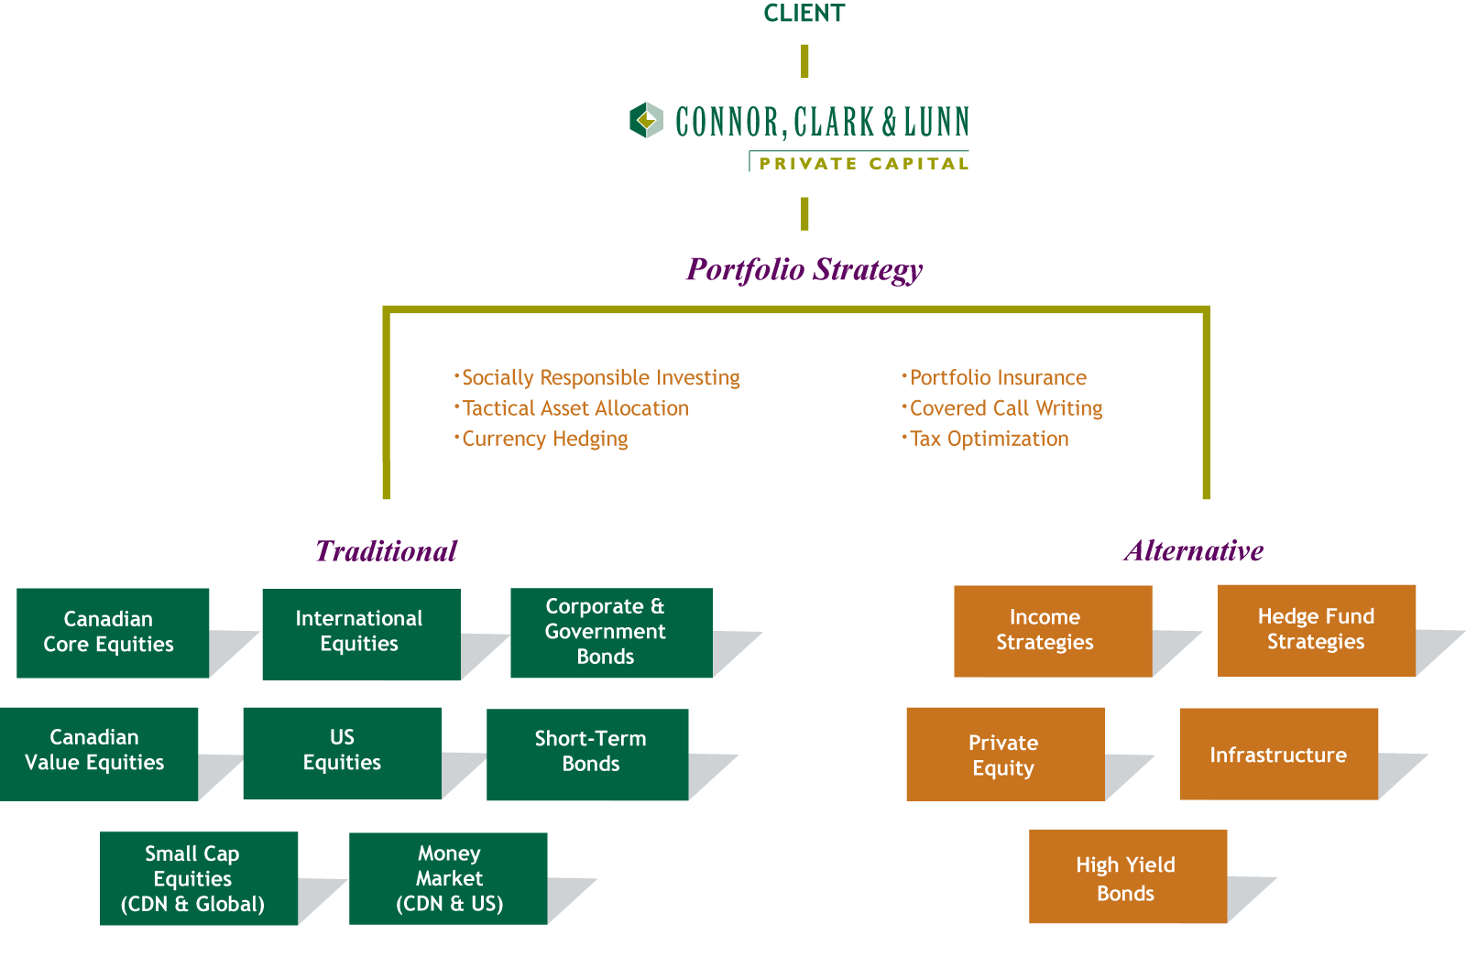
Investment Teams and Alternatives
As needs
change &
markets
evolve,
we respond
Notes:
Like most firms we started 20 years ago and still today with a traditional approach to managing money… stocks , bonds and cash
It worked well and provided good diversification for our clients. As everyone heard in the 90’s – diversify outside of Canada – don’t keep all your eggs in one basket. Well that is true still today…. However global markets are much more inter connected today and as we noticed during the bear market over the last few years there are times when all global markets can actually go down together.
At our firm, we recognized that and started to build a space for alternative investments. Assets that would be able to provide unique additions to a traditional portfolio… instruments like high yield bonds, income trusts and hedge fund strategies that could provide similar returns to traditional investments but be less reliant on those traditional markets to do so. In short… provide additional diversification to a balanced portfolio.

Slide 10
Asset Mix – Portfolio Strategy Decisions
Balanced Portfolio
Q3 2003
Balanced Portfolio
Q1 2007
Balanced Portfolio
Q2 2008
Small
Cap
4%
Global
52%
Canadian
Value
27%
Income
5%

Slide 11
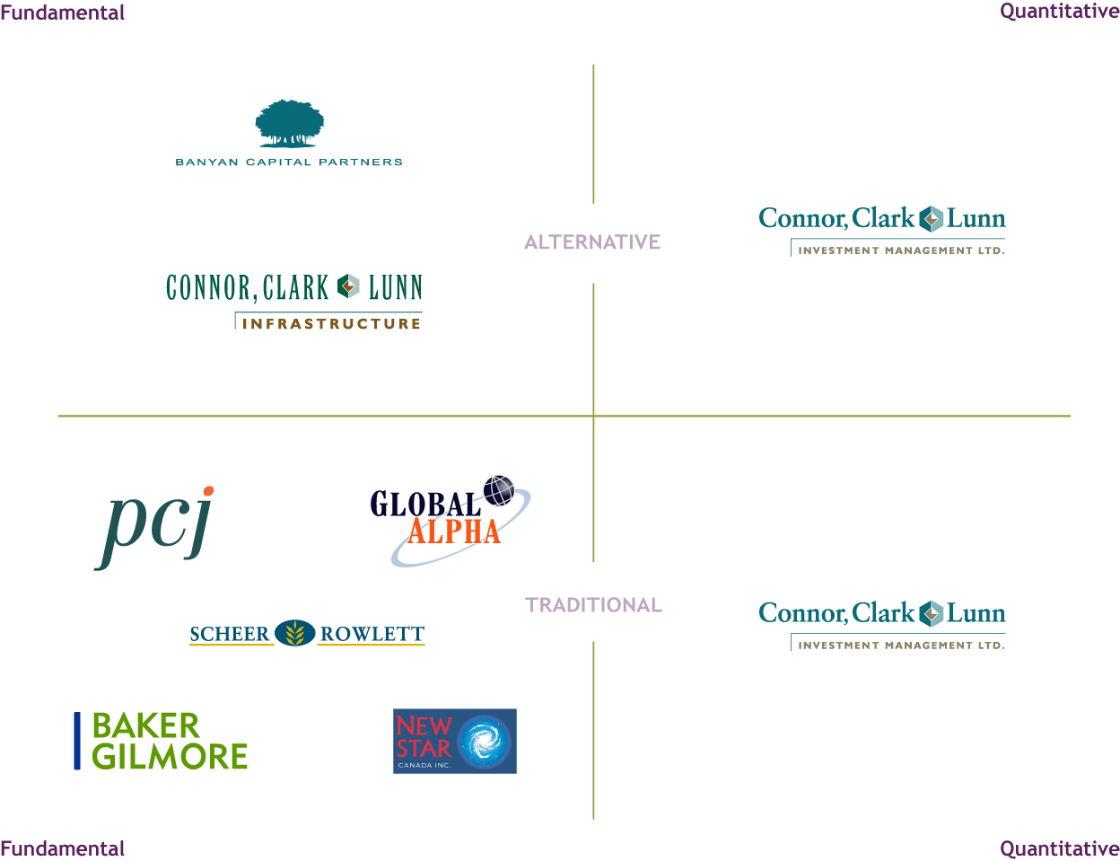
CC&L Financial Group
Multi-asset class,
multi-product, multi-style
Affiliates complement,
not compete
with each other

Slide 12

Tax Effectiveness
Proactive tax planning during transition of assets
Balance our investment view with your tax liability
(i.e., use of “Hurdle Rates”)
Harvest losses to offset gains
Separate taxable investors from non-taxable investors
Reduce turnover in taxable portfolios
Pay close attention to taxable gains before distributions are made
View clients total wealth across all accounts — allocate high tax generating assets to low tax sensitive portfolio
Delivering competitive net, net returns

Slide 13
Efficient Tax Allocations – For entire Family
Asset Class Location Strategy Designed Specifically for each client situation
Reducing overall tax paid
Client
Taxable
Client RRSP
Spouse
Taxable
Spousal
RRSP
Holding Co.
Spouse
RRSP

Slide 14

Efficient Tax Allocation – tax minimization
Portfolio efficiency is enhanced through asset location strategy
After tax Yield is increased by almost 15% while maintaining overall asset mix
$ 1,000,000 investment in bond portfolio is assumed to yield interest income of $100,000. $1,000,000 investment in stock portfolio is assumed to yield capital gain of $100,000. Taxation rates based upon Ontario resident, highest marginal rates. For illustrative purposes only and does not reflect actual or expected performance

Slide 15

Service and Communication
Highly qualified service specialists keep clients well informed leading to high levels of satisfaction and stability
  Allows money managers to focus all their time on the markets
  Quick response to ad-hoc requests
  Regular face-to-face meetings
Client communication is critical, our investment in systems is paying off and clients are pleased with the results
  Clear & concise quarterly reports
  Website account access 24 hours a day (daily updates)
  Full tax reporting package
  Regular newsletter (Inside Outlook)
A two-tier service model that will keep you and your client’s happy

Slide 16
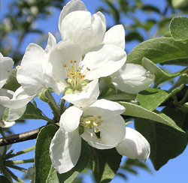
What Makes Us Unique?
“Experience, Flexibility, Simplicity,
Value and Safety”
Unique structure focused on preserving & growing capital
Multiple style teams for changing market
Traditional and alternative asset classes
An active approach for uncertain times
Exceptional service & communication – one contact & clear, concise reporting

Slide 17
Appendices
A – Balanced Portfolio Performance
B – Sample Quarterly Report
C – Sample Tax Report
D – Client Testimonials & Articles of Interest
E – Inside Outlook Newsletter & Benefits Checklist

Slide 18

CC&L Private Capital Benefits
Investment Policy
1. Personal risk profile developed in conjunction with leading behavioural finance methods
2. Analysis of your unique, capital preservation, capital growth, income, liquidity and tax needs
3. Comprehensive written Statement of Investment Policy, inclusive of benchmark metrics
4. Statement of Investment Policy that encompasses entire family needs
5. Portfolio diversification across geography, capitalization and investment styles
6. Portfolio diversification across eight distinct asset classes
7. Optional alternative asset class structures further enhancing diversification offering
8. Portfolio constructed with minimal cash balances in investment pools, gaining maximum benefit of asset class
9. Tactical Asset Allocation framework, taking best advantage of market opportunities
CC&L
Other
Portfolio Management
1. Global team of professionals managing each asset class
2. Focus of each team on specific market discipline
3. Style mandates, including, growth, value and quantitative
4. Tax Efficiency
a) Optimization across multiple family accounts
b) Income allocation as markets and performance warrant
c) Fee directability - enhanced sheltered asset growth
5. Tactical portfolio strategy consistent with personal risk/return profile
6. Pooled, Segregated or combination portfolios
CC&L
Other

Slide 19
CC&L Private Capital Benefits
CC&L
Other
Reporting
1. One consolidated report across all accounts
2. Providing key information quarterly
3. a) Capital invested and current market value
b) Historical rates of return over various periods, compared to a benchmark
c) Changes in portfolio since last reporting period
4. Simplified annual tax information including capital gains, income, dividends and return of capital
5. On-line access for clients and advisors
CC&L
Other
Relationship
1. Dedicated Portfolio Manager understanding your accounts
2. Periodic meetings at the discretion of yourself and your advisor
3. Investment Counselor partner - working with your current professionals - advisor/accountant/lawyer
CC&L
Other
Fees
1. Management fee - based upon asset base managed
2. Management fee - declining scale for incremental assets managed
3. Performance fees - based upon out-performing a benchmark hurdle
Intangibles
1. Professionalism – professional corporate culture
2. Historic stability - legacy of firm and customer loyalty
3. Reputation - industry/peer and client sentiment
4. Flexibility - to deliver solution consistent with your needs
CC&L
Other

